Slide 1



QUANTUM ARENA 1.0
Deepfake Detection
Problem Statement Title- Deepfake Detection Tool
Theme – AI / Cybersecurity
PS Category – Deepfake Detection
Team Name – GameA

Slide 2
Real Time Deepfake Detection System
GameA
Detects deepfake content in images & videos Uses facial landmark analysis + behavioral patterns Provides real-time AI probability score & verdict.
Rising misuse of deepfake videos / images Hard to detect fake content manually.
Combines :- Facial motion (jitter analysis).
-Symmetry detection (eye blink patterns) .
-Real-time frame-by-frame detection Light weight.
-Fast (runs locally).

Slide 3
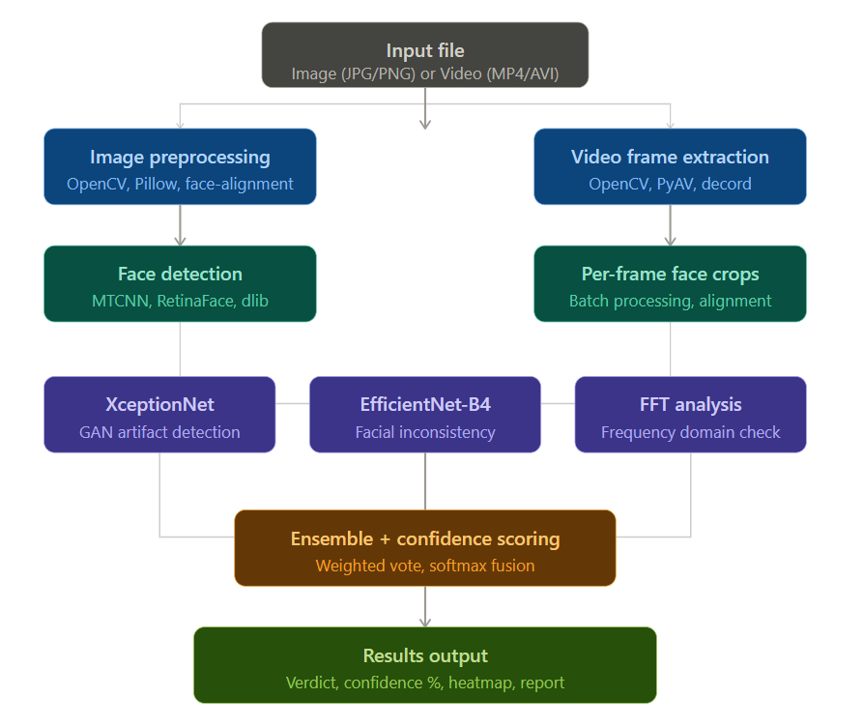
TECHNICAL APPROACH
GameA

Slide 4
FEASIBILITY AND VIABILITY
GameA
Feasibility: Uses existing libraries ( MediaPipe, OpenCV ) Works on normal systems (no heavy GPU required) Fast processing (real-time capable).
Challenges: Multiple faces in frame Low-quality videos Lighting variations.
Solutions: Improve detection thresholds Add preprocessing (enhancement filters) Extend model with ML training later.

Slide 5
IMPACT AND BENEFITS
GameA
Impact :
Helps detect fake media in-
- Social media
-News platforms
-Security systems
Benefits:
Prevent misinformation Improve digital trust Useful for law enforcement & media agencies
.

Slide 6
RESEARCH AND REFERENCES
GameA
Deepfake Detection Review (MDPI) – https://www.mdpi.com/2673-2688/7/2/68
Multimedia Deepfake Detection Survey (Springer) – https://link.springer.com/article/10.1007/s10791-025-09550-0
Facial Landmark-based Detection Study (MDPI) –
https://www.mdpi.com/2079-9292/13/1/126
Multimodal Deepfake Detection ( Arxiv ) –
https://arxiv.org/abs/2104.09770
Deep Learning Deepfake Detection Review (Arxiv) –
https://arxiv.org/abs/2202.06095
MediaPipe Documentation – https://developers.google.com/mediapipe
OpenCV Documentation – https://docs.opencv.org

Slide 7
REQUIREMENTS
GameA
Hardware Requirements
Processor: Intel Core i5 or equivalent (minimum).
RAM: 2 GB minimum (4 GB recommended).
Storage: 100 MB free disk space.
Input Device: Standard keyboard and mouse.
Software Requirements
Operating System: Windows 11 / macOS
Programming Language: Python 3.xPython
WebText Editor / IDE: VS Code

